Slide 1
数字电路与逻辑设计实验
计算机学院
黄倩怡
2024-2025学年第二学期

Slide 2
A general design procedure for sequential circuits
State Diagram
Next-State Table
Flip-Flop Transition Table
Karnaugh Maps
Logic Expressions for Flip-Flop Inputs
Counter Implementation

Slide 3
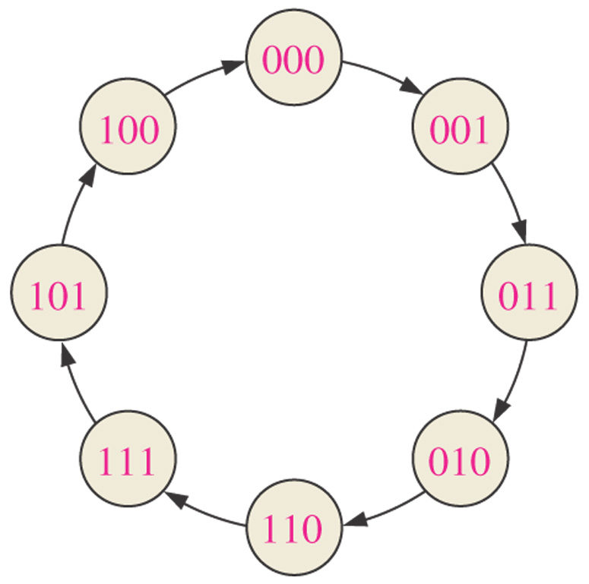
Example: Design of a basic 3-bit Gray code counter.
Step 1: State Diagram

Slide 4
Step 2: Next-State Table
Present State |  |  | Next State
Q2 | Q1 | Q0 | Q2 | Q1 | Q0
0 | 0 | 0 | 0 | 0 | 1
0 | 0 | 1 | 0 | 1 | 1
0 | 1 | 1 | 0 | 1 | 0
0 | 1 | 0 | 1 | 1 | 0
1 | 1 | 0 | 1 | 1 | 1
1 | 1 | 1 | 1 | 0 | 1
1 | 0 | 1 | 1 | 0 | 0
1 | 0 | 0 | 0 | 0 | 0

Slide 5
Step 3: Flip-Flop Transition Table
Transition table for a J-K flip-flop
Output Transitions |  |  | Flip-Flop Inputs
QN |  | QN+1 | J | K
0 | → | 0 | 0 | X
0 | → | 1 | 1 | X
1 | → | 0 | X | 1
1 | → | 1 | X | 0
QN: present state
QN+1: next state
X: “don’t care”

Slide 6
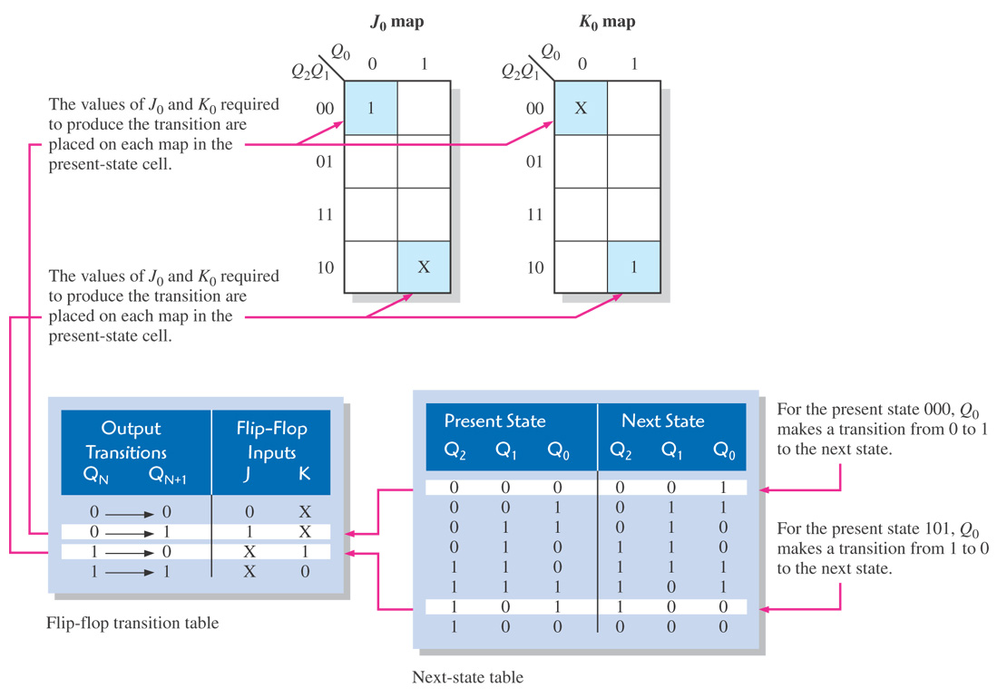
Step 4: Karnaugh Map

Slide 7
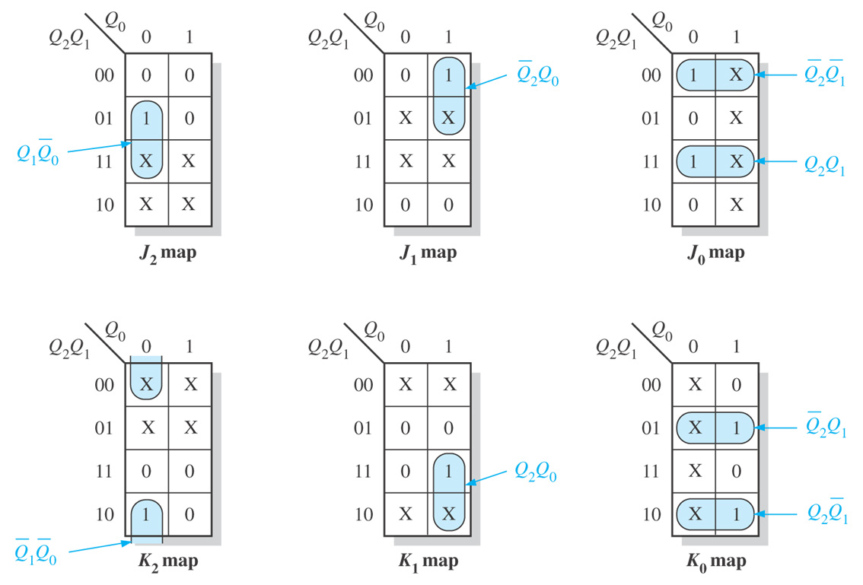

Slide 8
Step 5: Logic Expressions for Flip-Flop Inputs

Slide 9
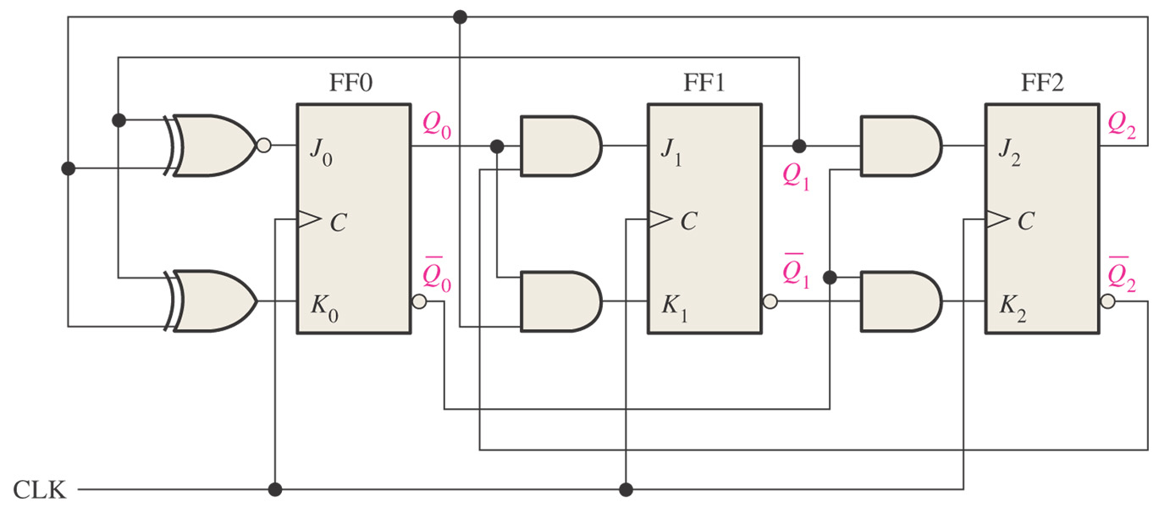
Step 6: Counter Implementation

Slide 10
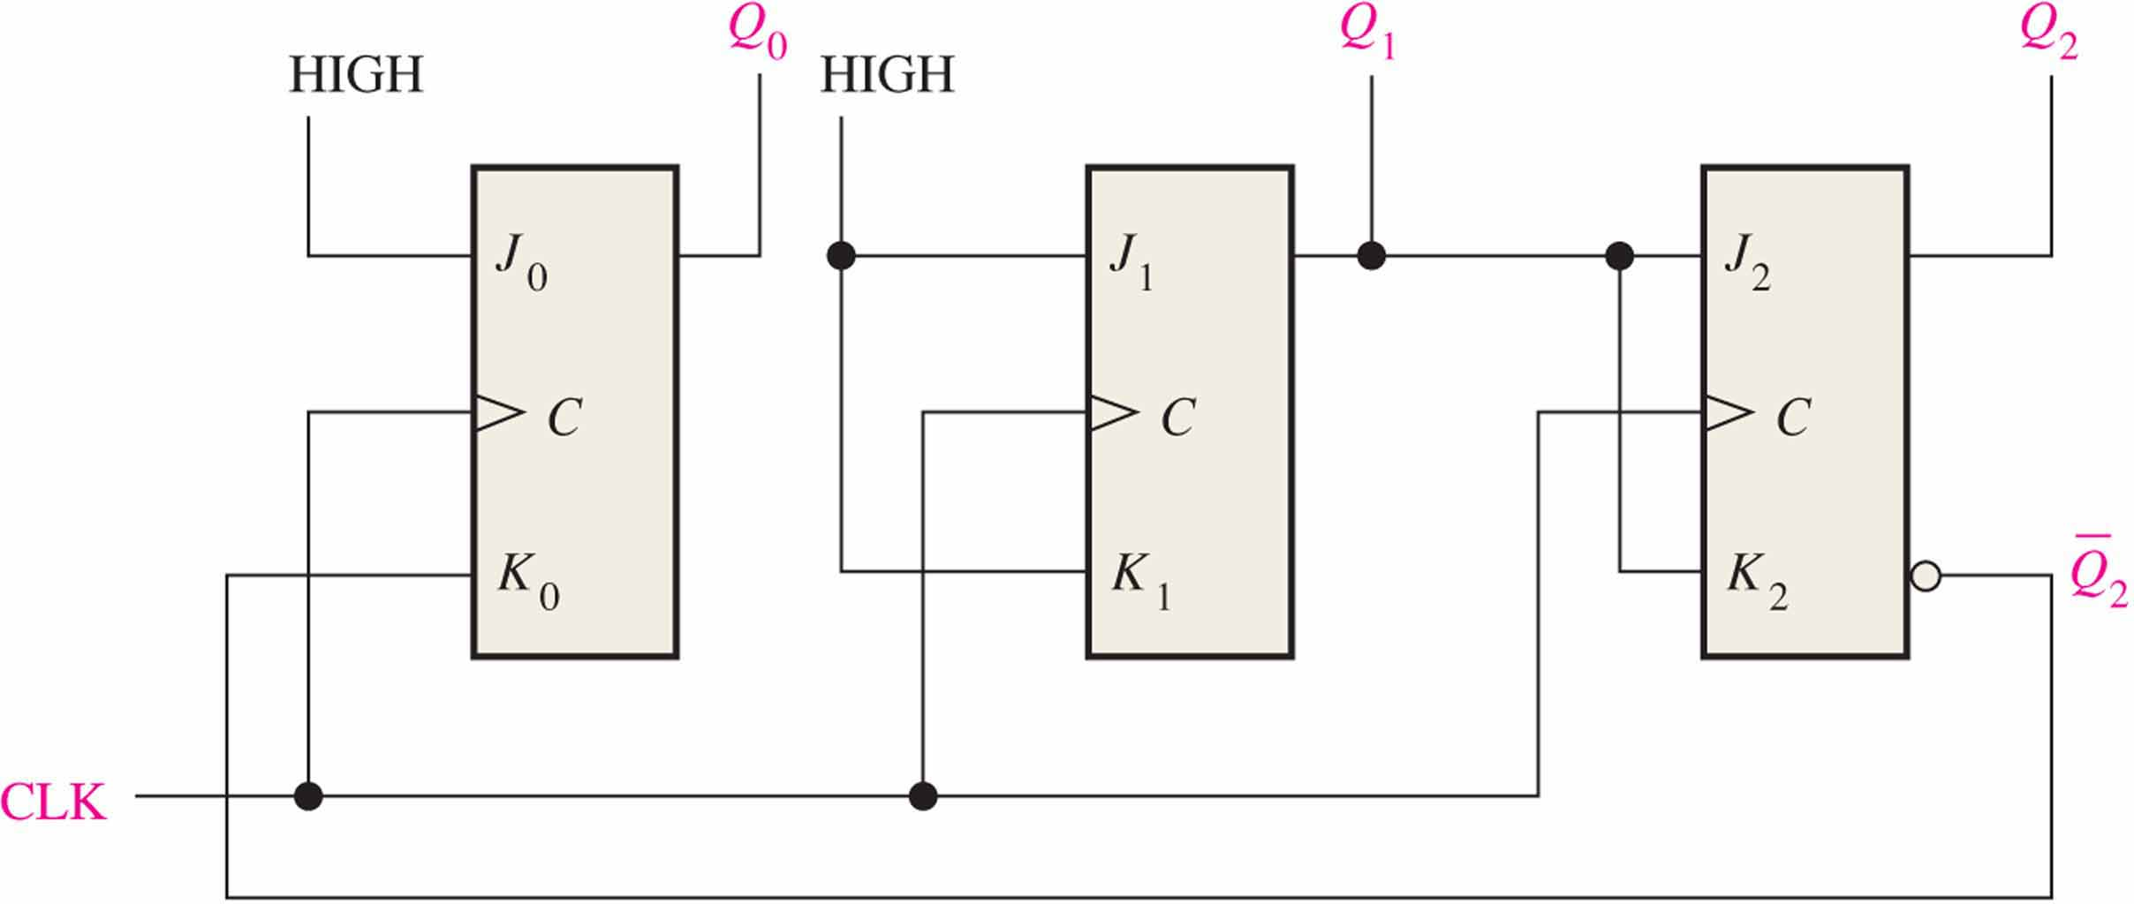
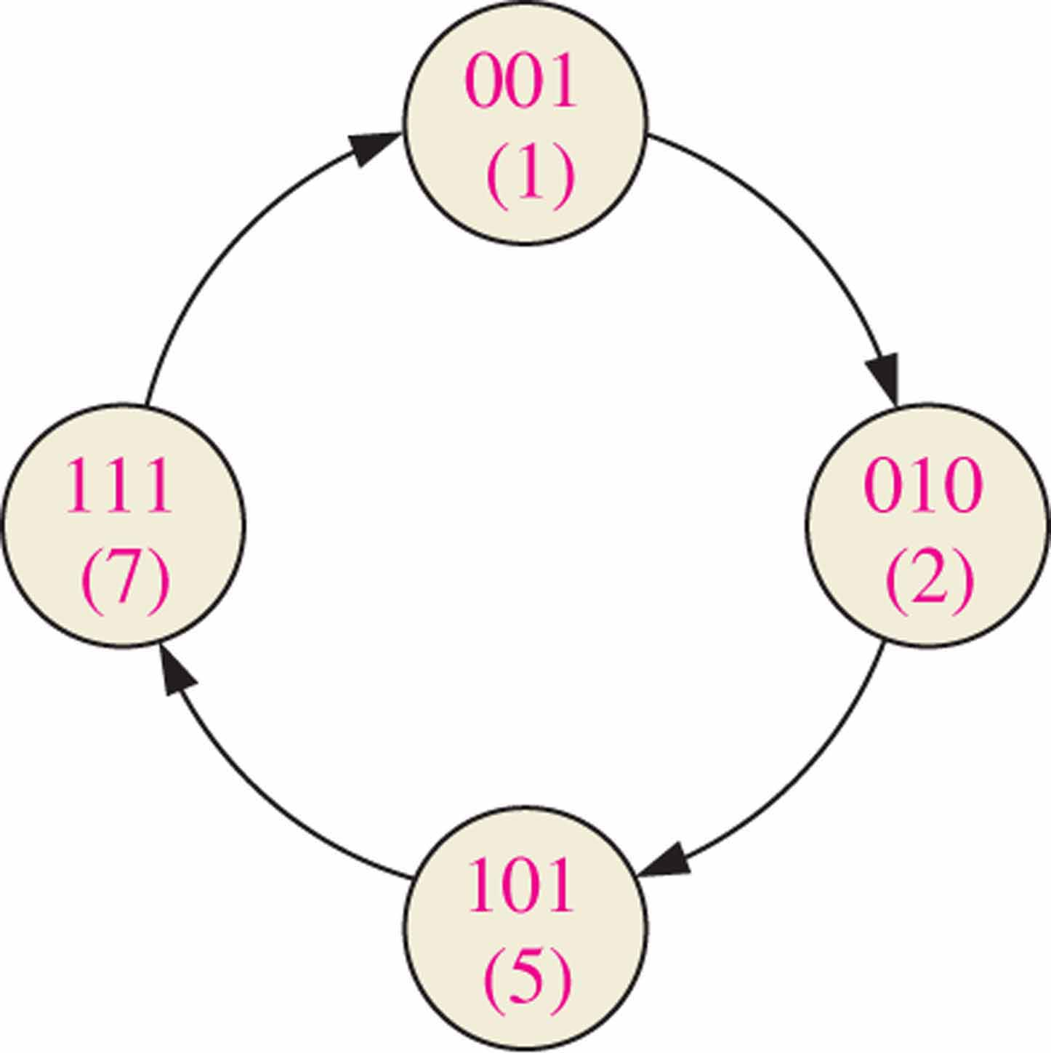
Step 7: Check whether the circuit is able to self start (Optional)
Determine if the circuit is able to enter one of the desired states (in the state diagram) after a finite number of transitions.
If it can not, you may have to re-design the circuit.

Slide 11
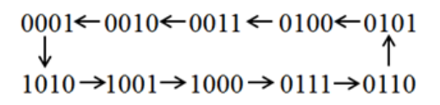
实验内容
用 J-K 触发器和门电路设计一个特殊的十进制同步计数器，将计数结果在7段管码上显示。
注意：这个十进制同步计数器没有 0000、 1011、 1100、 1101、 1110、 1111状态，电路设计要考虑自启动。

Slide 12
拓展
使用74LS160十进制计数器实现
使用74LS197十六进制计数器实现
特殊计数：某一状态出现两次
01-10-11-00-10-01
D触发器实现
减少启动等待环节

